Slide 1
频率原则算法与理论
许志钦
2024年3月12日

Slide 2
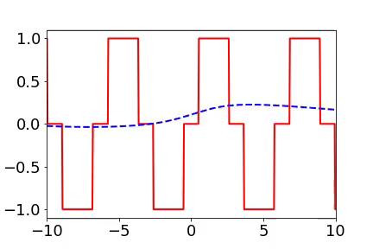
Training process of 1d example in spatial domain
From landscape to detail
Red:
target function
Blue:
DNN fitting
1807.01251

Slide 3
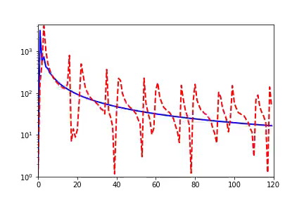
Training process of 1d example in Fourier domain
Frequency principle: From low frequency to high frequency
Red:
target function
Blue:
DNN fitting
Amplitude
Frequency
1807.01251

Slide 4
Difficulty of frequency attracts attention
An important principle for the convergence of the DL networks and PINN networks is the Frequency-principle
Markidis, arxiv: 2103.09655
Recently, frequency analysis on Convolution Neural Networks (CNNs) has attracted more and more attention…
Bin Li et al., arxiv: 2103.11093
In this work, we shall use the F-principle to observe the performance of adaptive activation function
Jagtap and Karniadakis, Journal of Computational Physics, 2020.
Fourier Features Let Networks Learn High Frequency Functions in Low Dimensional Domains
Tancik et al., 2020
……

Slide 5
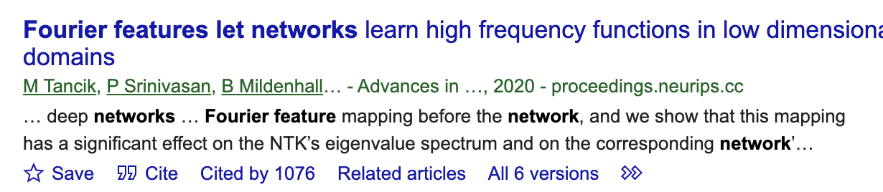
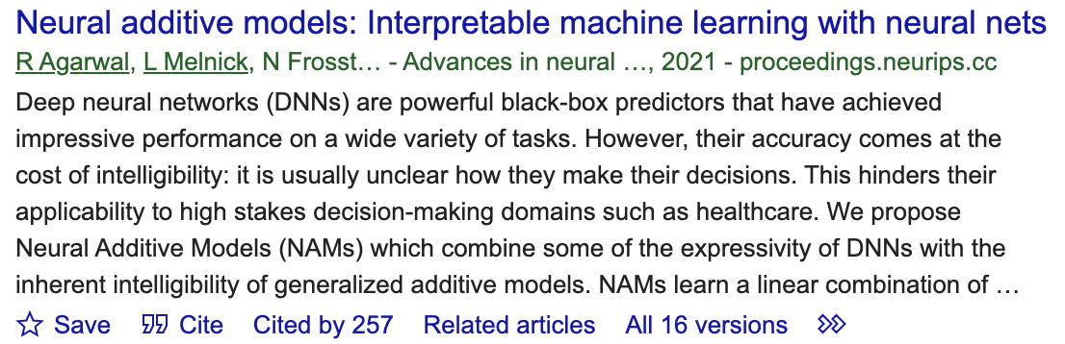
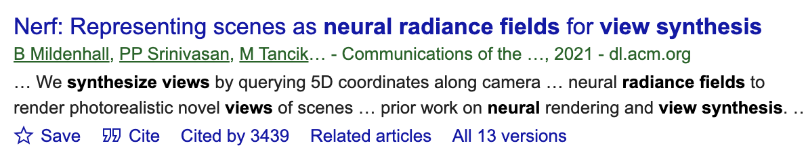
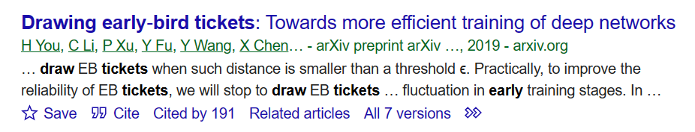
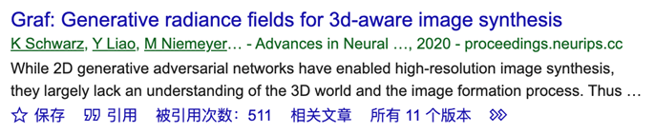
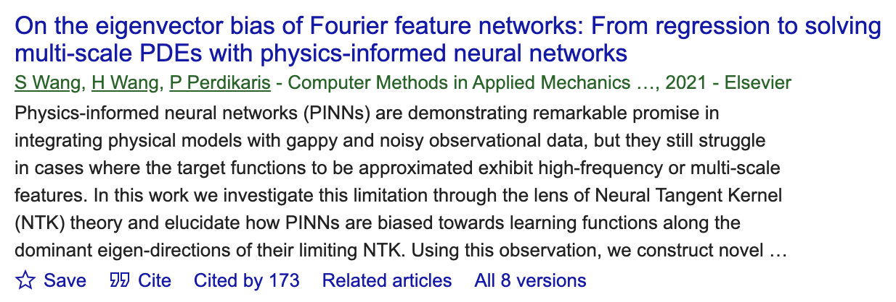
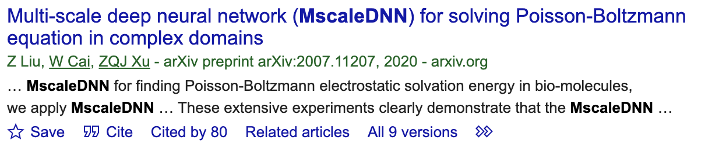
Algorithms inspired by F-Principle

Slide 6
MscaleDNN
Liu, Cai, Xu*, MscaleDNN, 2007.11207, CiCP

Slide 7
Radial scaling in k-space
Liu, Cai, Xu*, MscaleDNN, 2007.11207, CiCP

Slide 8
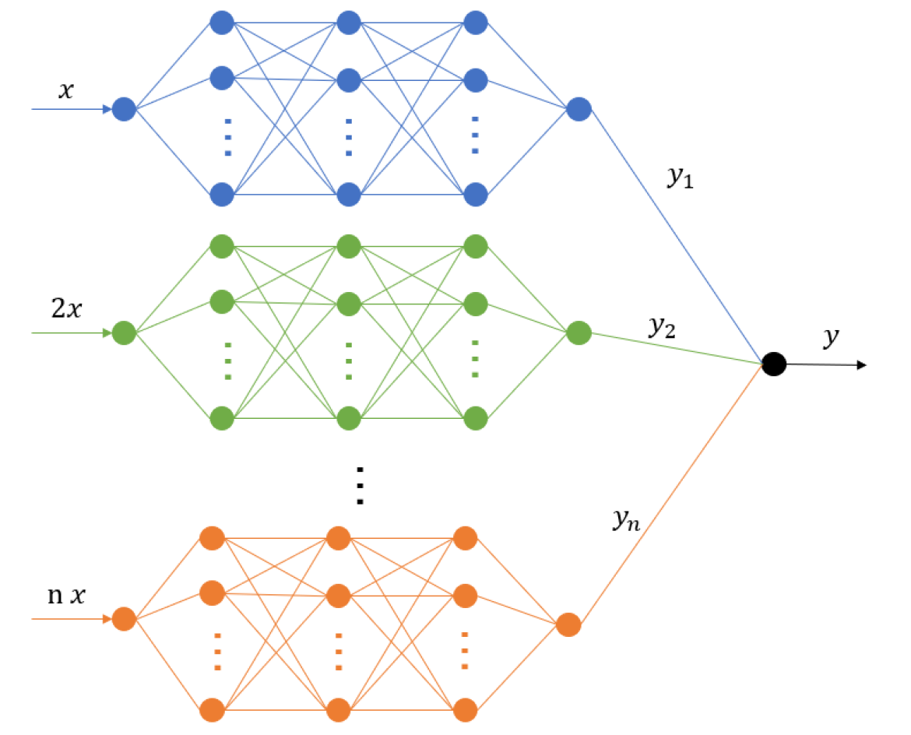
MscaleDNN structures
Giving a MscaleDNN
$f\left(x\right)=\sum_{i=1}^{10}{a_{i}σ(w_{i}x+b_{i})}$+ $\sum_{i=11}^{20}{a_{i}σ(2w_{i}x+b_{i})}$+ $\sum_{i=21}^{30}{a_{i}σ(3w_{i}x+b_{i})}$
Liu, Cai, Xu*, MscaleDNN, 2007.11207, CiCP

Slide 9
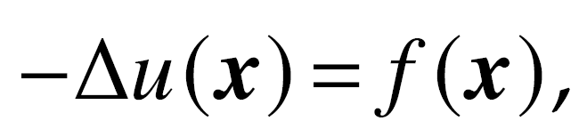
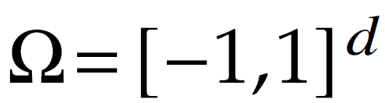
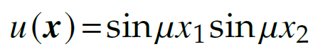
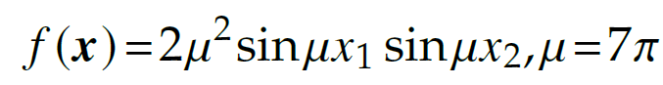
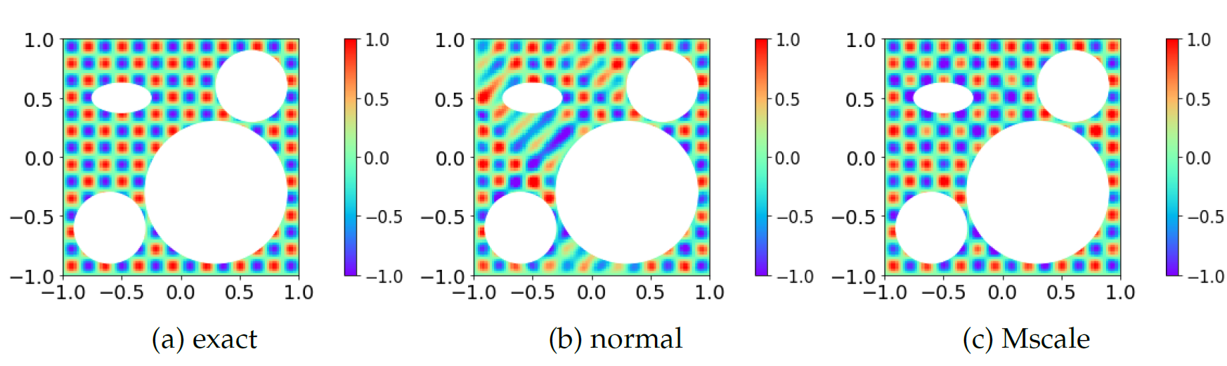
Two dim case: complex domain
Liu, Cai, Xu*, MscaleDNN, 2007.11207, CiCP

Slide 10
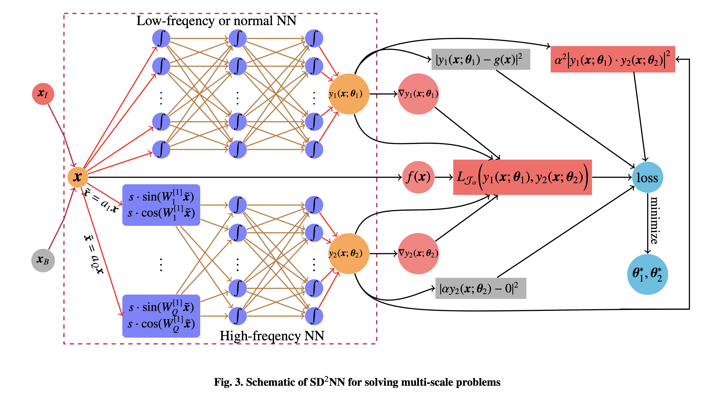
Sub-space decomposition
Xi-An Li, Zhi-Qin John Xu, Lei Zhang * , SD2NN, arxiv 2112.06660

Slide 11
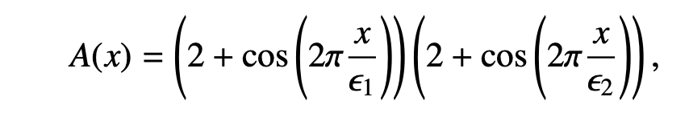
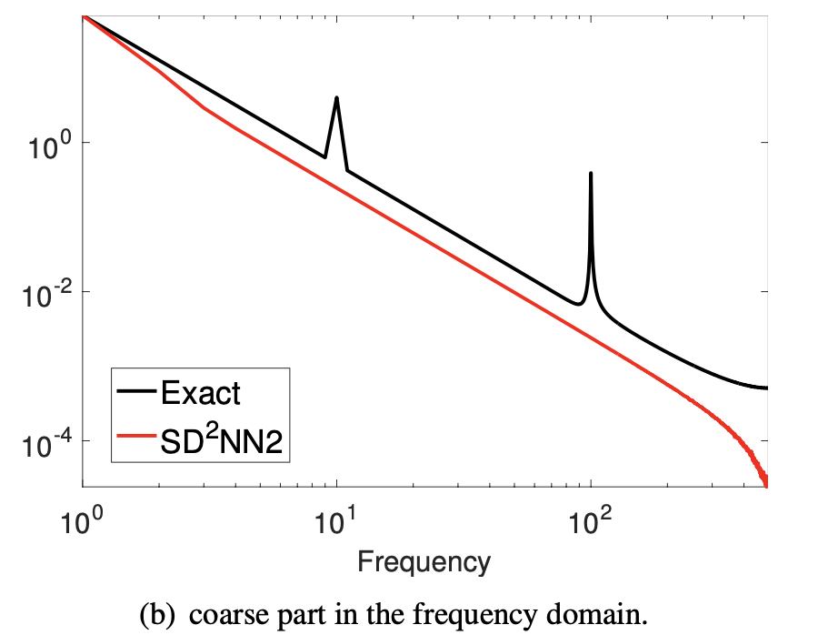
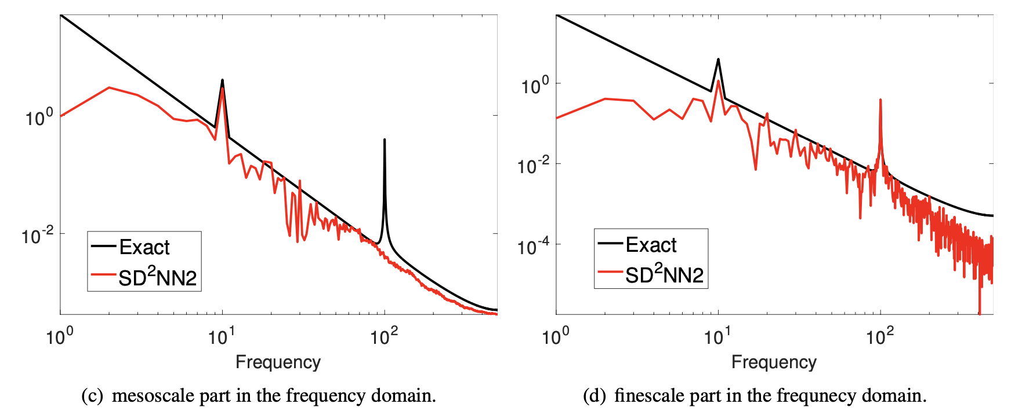
Sub-space decomposition
Xi-An Li, Zhi-Qin John Xu, Lei Zhang * , SD2NN, arxiv 2112.06660

Slide 12
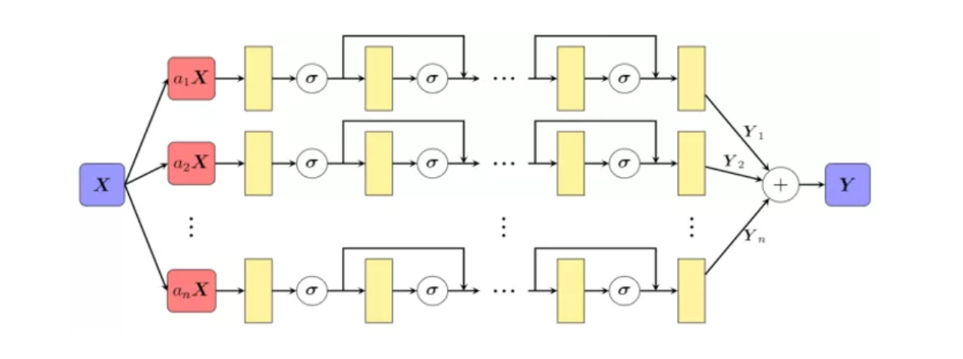
Huawei：MindSpore Science for Maxwell equations
Huang X et al. Solving Partial Differential Equations with Point Source Based on Physics-Informed Neural Networks, arXiv:2111.01394, 2021

Slide 13
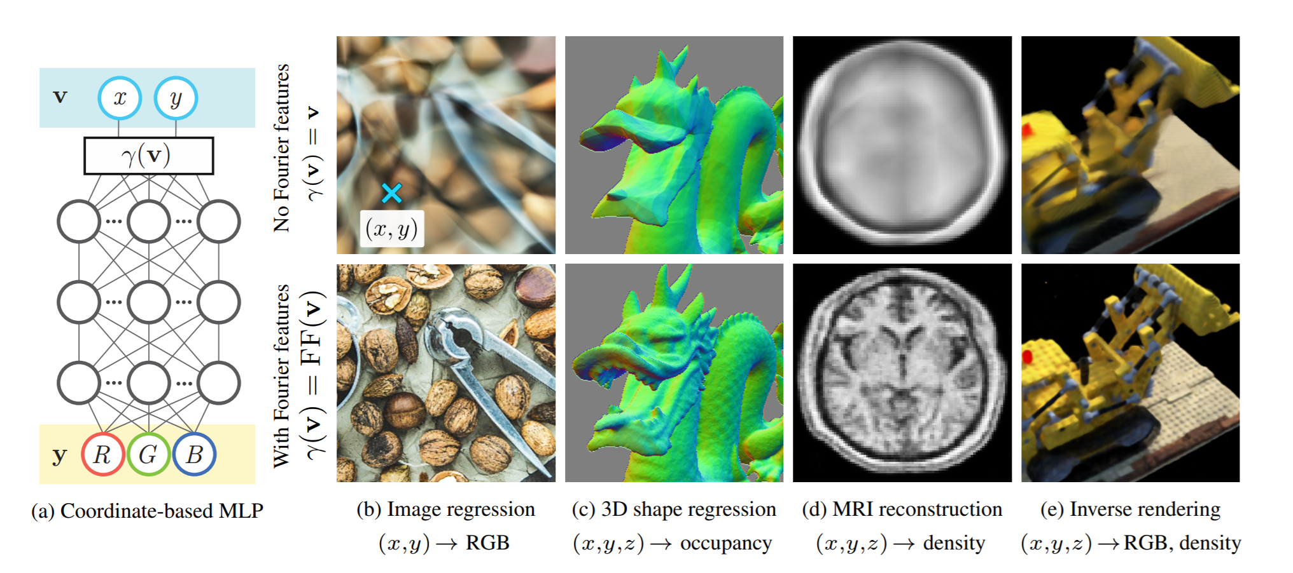
Fourier Features Networks
Tancik et al., 2020

Slide 14
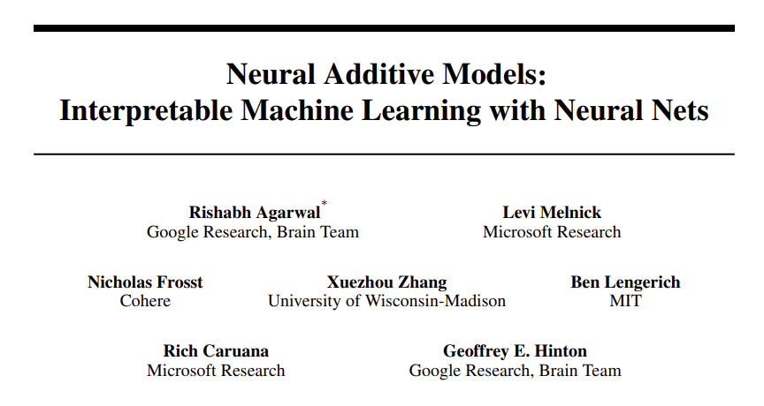
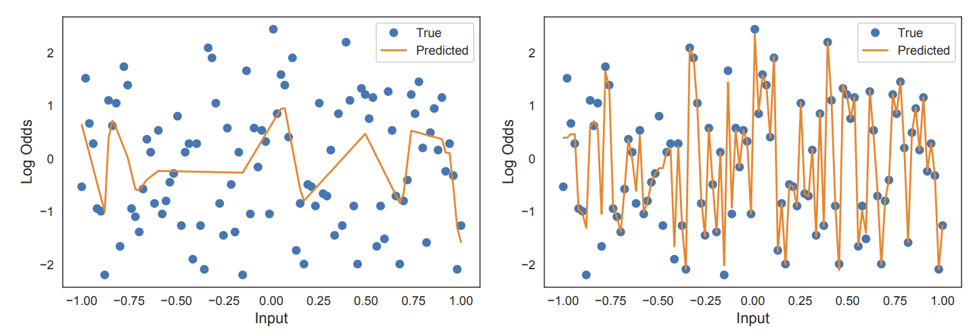
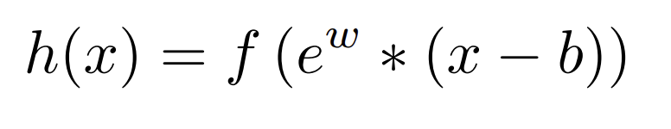
Exp-centered (ExU) hidden units (Hinton’s group)
Exp-centered (ExU) hidden units

Slide 15
频率原则启发的算法设计得到广泛使用

Slide 16
Why frequency principle?
Learn from low to high frequency

Slide 17
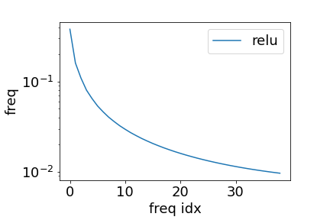
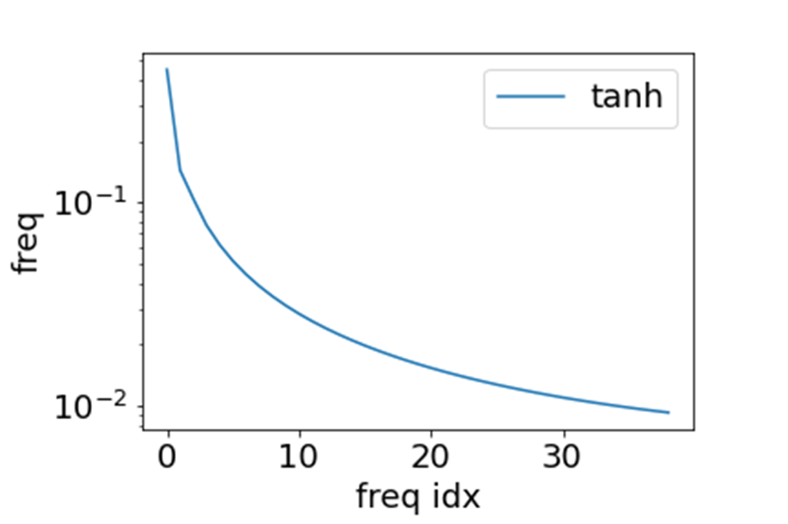
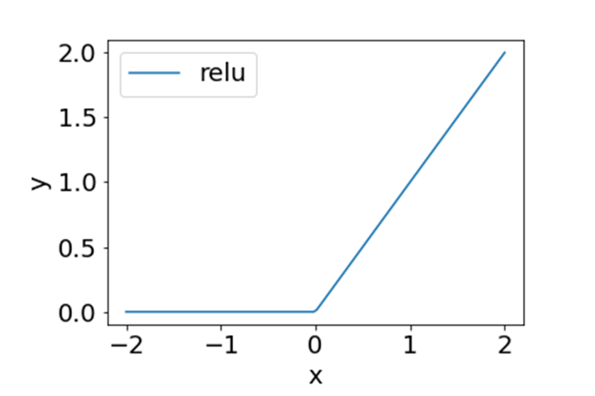
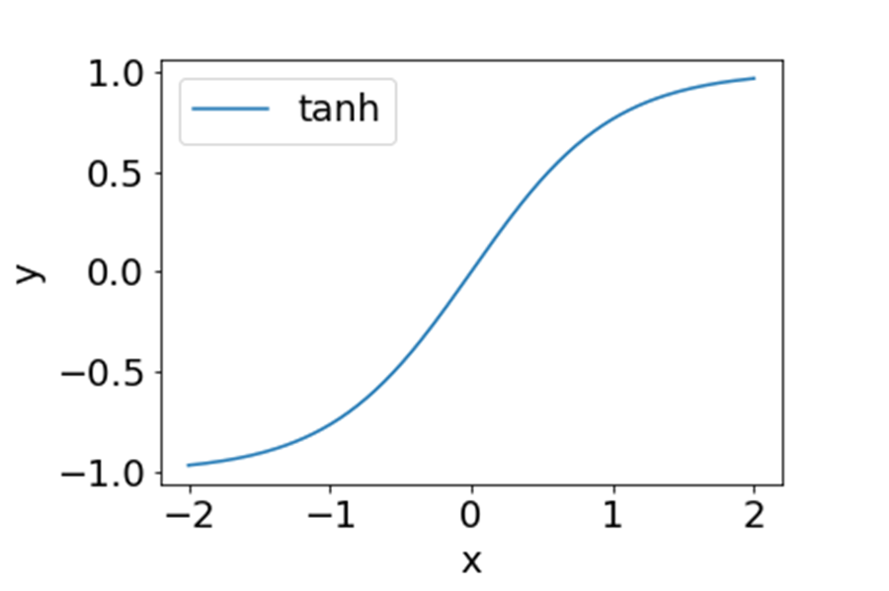
ReLU and Tanh in Fourier domain
Decay with frequency

Slide 18
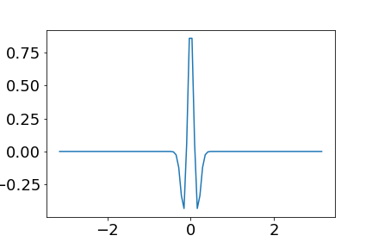
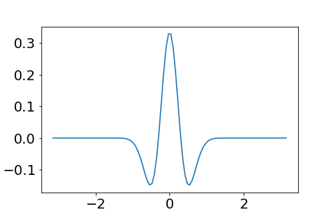
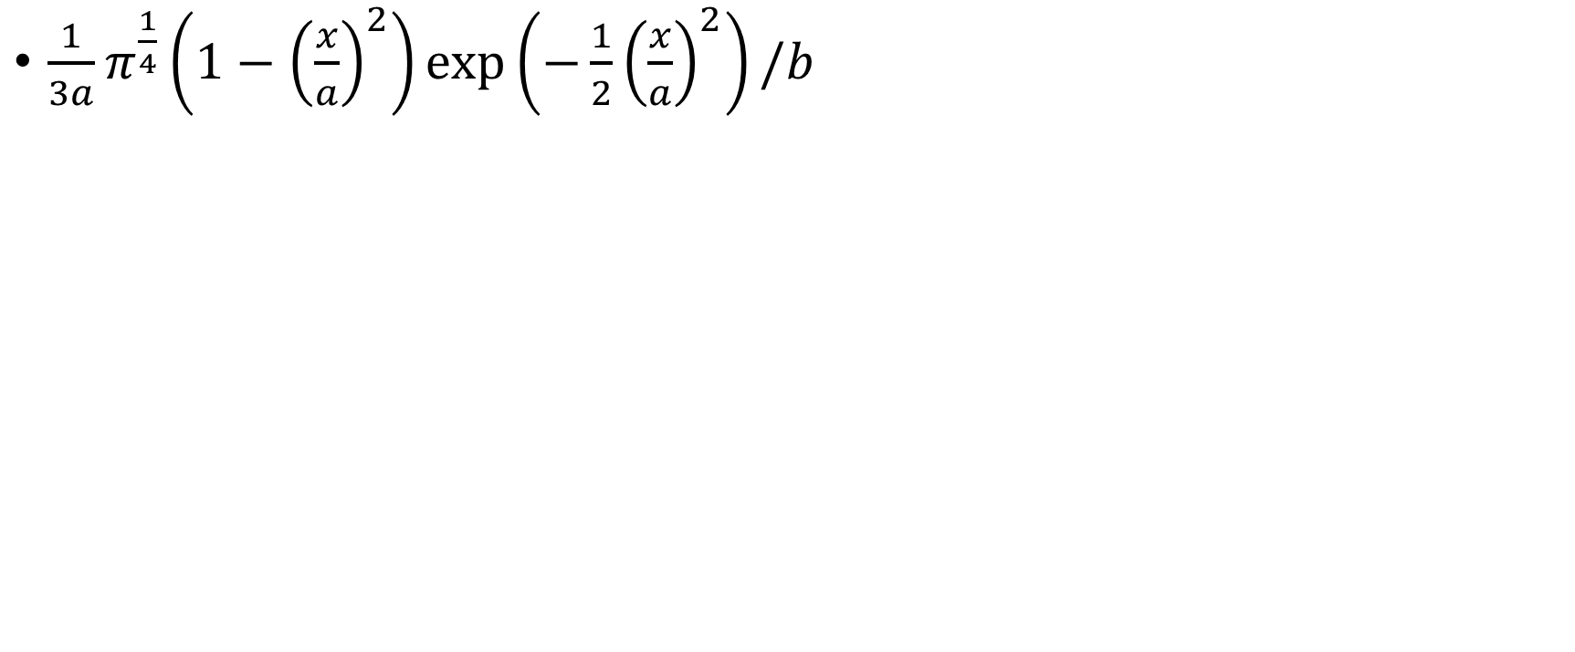


Activation function
$\frac{1}{3a}π^{\frac{1}{4}}\left(1−{\left(\frac{x}{a}\right)}^{2}\right)\exp\left(−\frac{1}{2}{\left(\frac{x}{a}\right)}^{2}\right)/b$
$$a=0.1, b=5$$
$$a=0.3, b=5$$

Slide 19
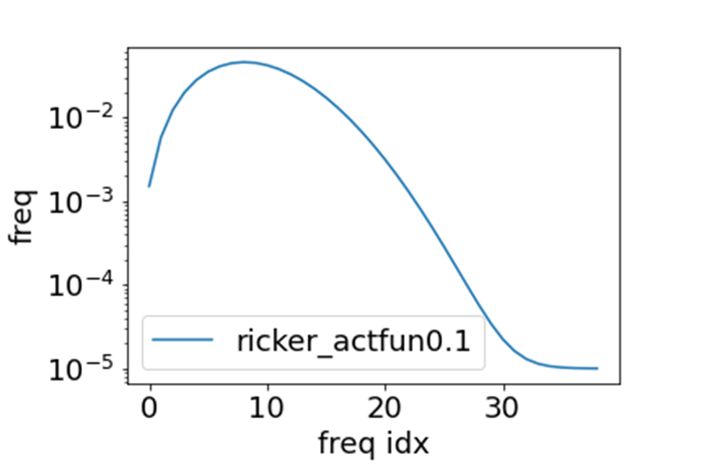
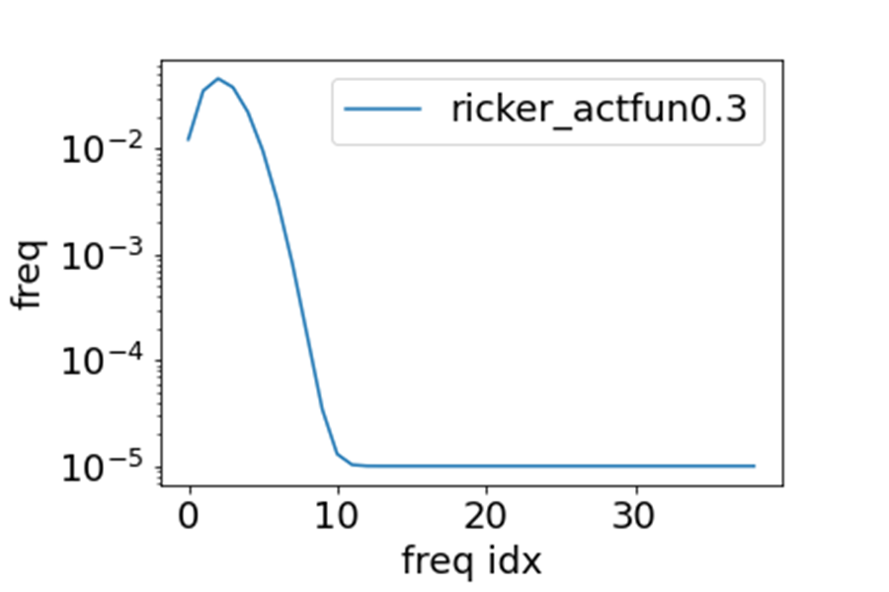
Activation function in Fourier domain
$\frac{1}{3a}π^{\frac{1}{4}}\left(1−{\left(\frac{x}{a}\right)}^{2}\right)\exp\left(−\frac{1}{2}{\left(\frac{x}{a}\right)}^{2}\right)/b$
$$a=0.1, b=5$$
$$a=0.3, b=5$$

Slide 20
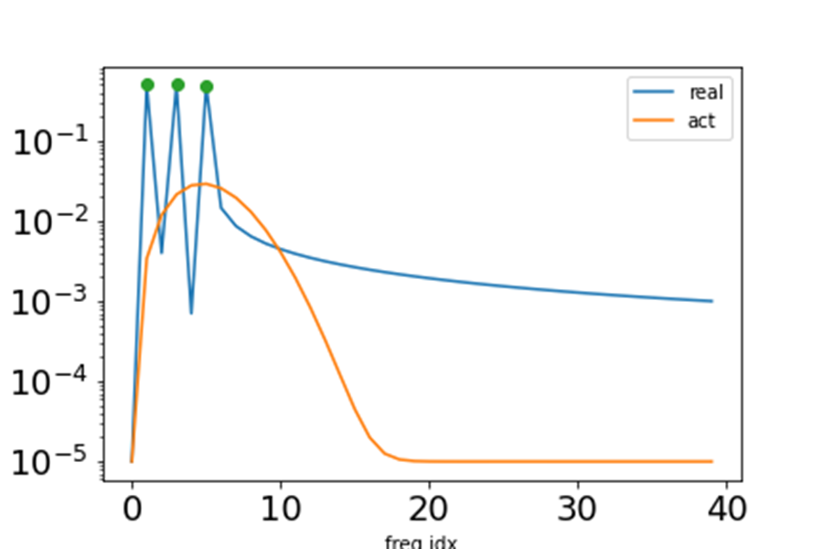
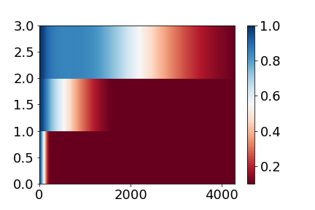
Clear Frequency principle
Low frequency faster
Relative error of three frequencies
Activation
Frequency domain
220908154157

Slide 21
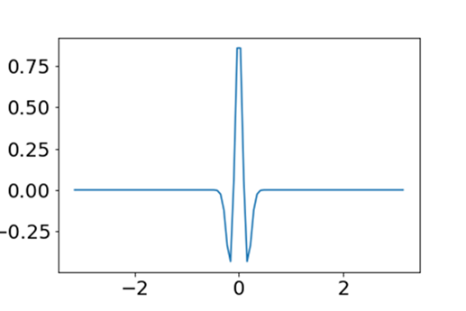
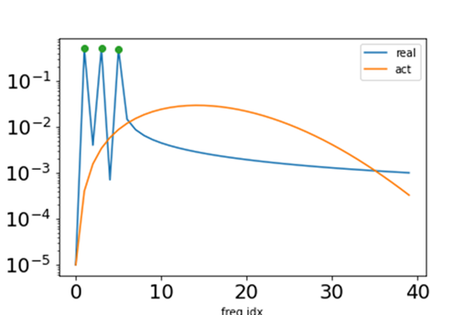
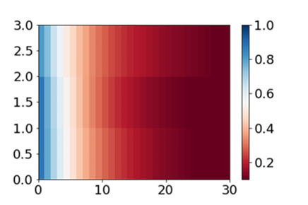
No Frequency principle
no frequency faster
Relative error of three frequencies
Activation
Frequency domain
220908154157

Slide 22
Key 1: the decay of activation in Fourier domain

Slide 23
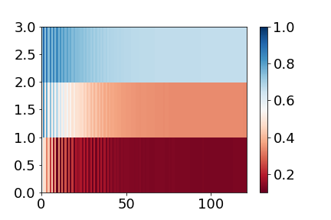
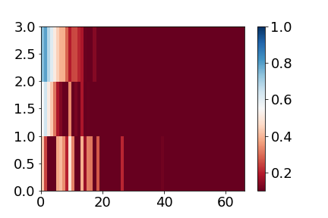
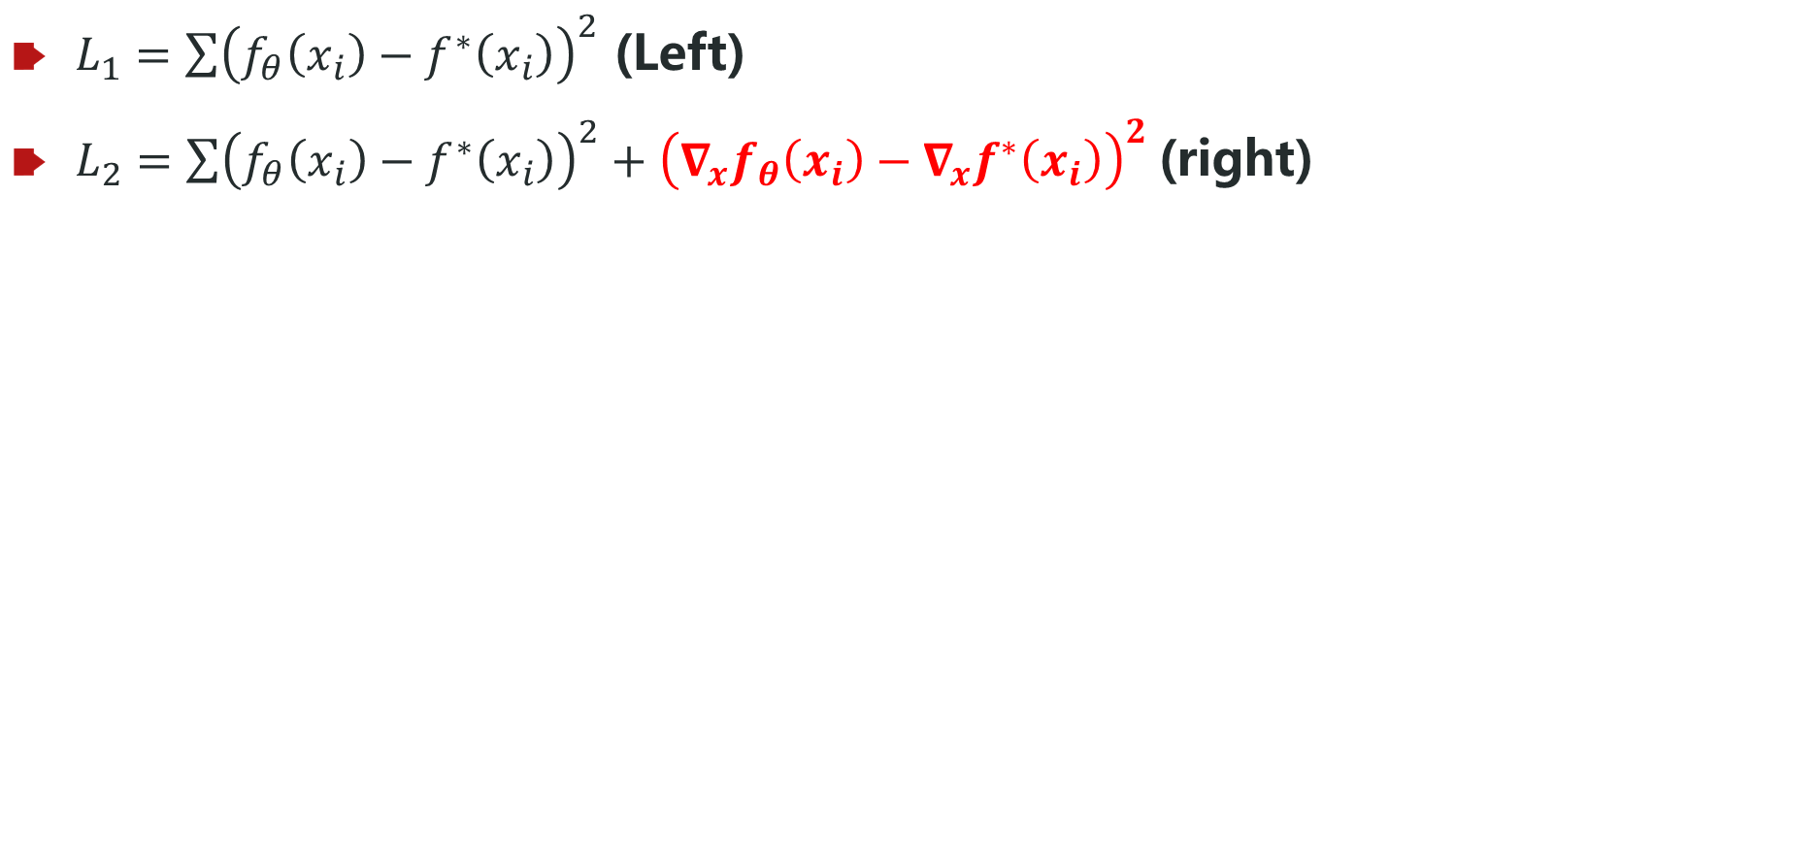
Gradient accelerates the high-freq speed
$L_{1}=\sum{{\left(f_{θ}\left(x_{i}\right)−f^{∗}\left(x_{i}\right)\right)}^{2}}$ (Left)
$L_{2}=\sum{{\left(f_{θ}\left(x_{i}\right)−f^{∗}\left(x_{i}\right)\right)}^{2}+{\left({∇_{x}f}_{θ}\left(x_{i}\right)−∇_{x}f^{∗}\left(x_{i}\right)\right)}^{2}}$(right)
ReLU, same target
[100, 200, 100]
Adam

Slide 24
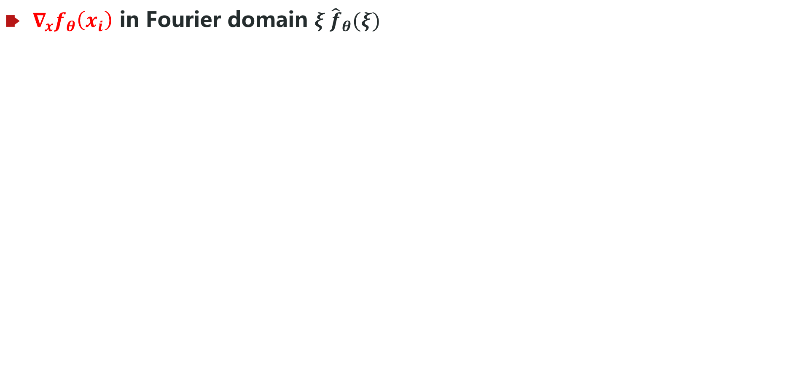
Gradient accelerates the high-freq speed
${∇_{x}f}_{θ}\left(x_{i}\right)$ in Fourier domain $ξ {\hat{f}}_{θ}(ξ)$
Equivalent to add more weight for high frequency

Slide 25
Key 2: the weight of frequency in loss function

Slide 26
Why we need frequency principle?
Zhi-Qin John Xu*, Yaoyu Zhang, Tao Luo,
Overview frequency principle/spectral bias in deep learning. arxiv 2201.07395 (2022)

Slide 27
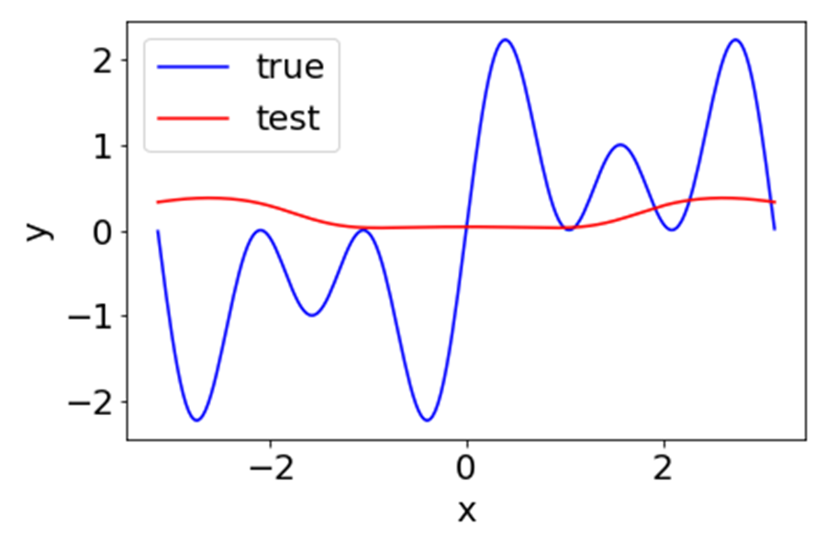
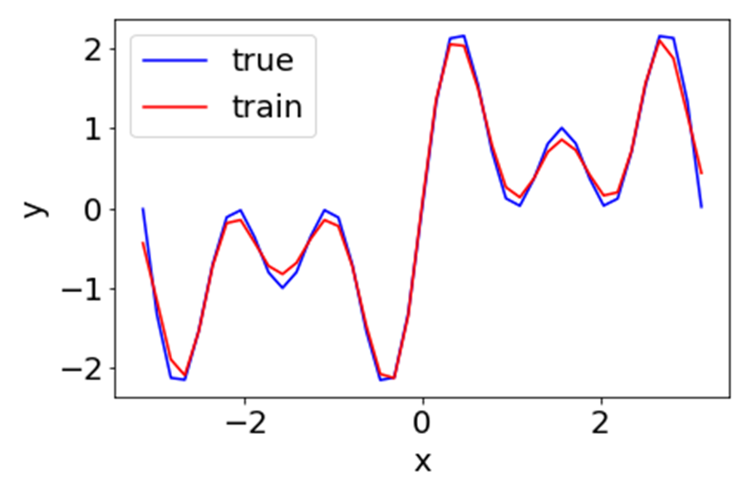
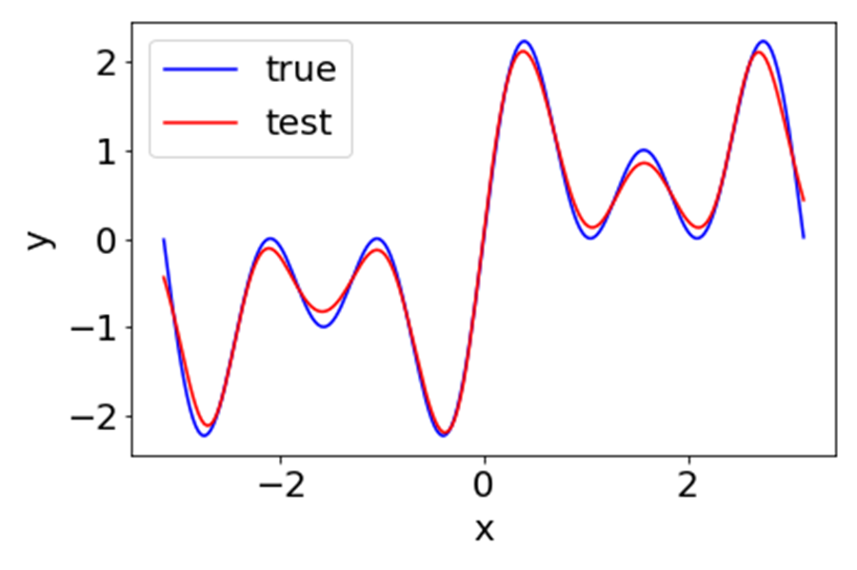
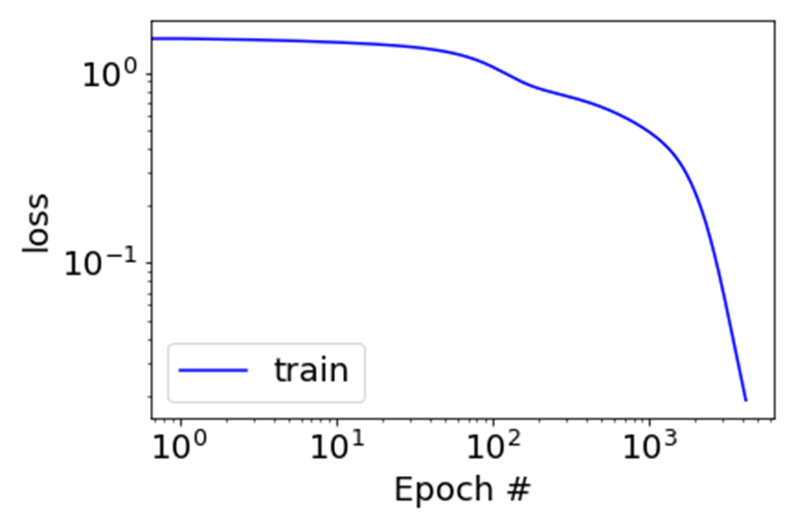
Clear Frequency principle, flat interpolation
Low frequency faster
Activation
Frequency domain
Initial epoch
Relative error of three frequencies
Final, training points
Final, test points
Loss
Zhi-Qin John Xu*, Yaoyu Zhang, Tao Luo,
Overview frequency principle/spectral bias in deep learning. arxiv 2201.07395 (2022)
220908154157

Slide 28


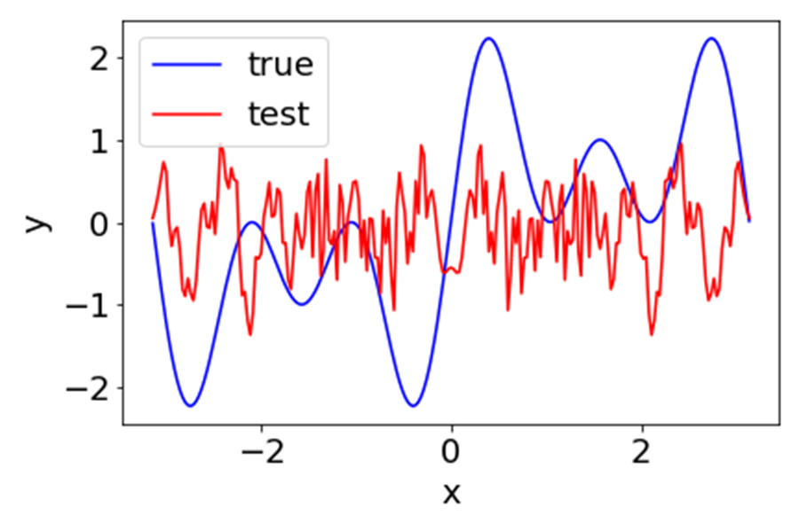

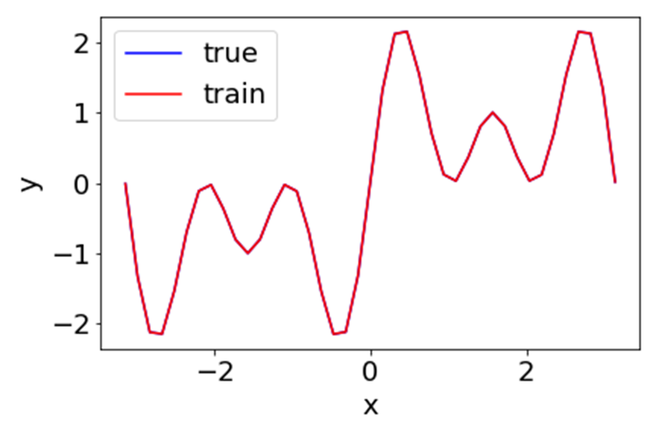
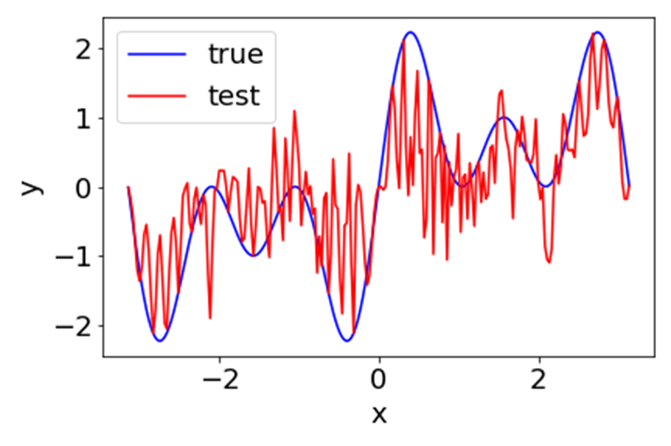
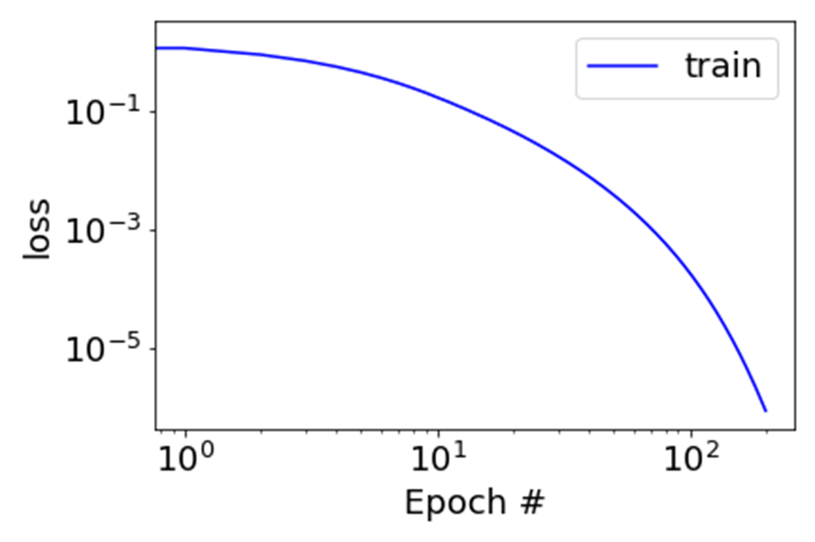
no Frequency principle, oscillated interpolation
No frequency faster
Activation
Frequency domain
Initial epoch
Relative error of three frequencies
Final, training points
Final, test points
Loss
Zhi-Qin John Xu*, Yaoyu Zhang, Tao Luo,
Overview frequency principle/spectral bias in deep learning. arxiv 2201.07395 (2022)
220911183904

Slide 29
Theory Understanding: one hidden layer, 1-d function

Slide 30



DNN: one hidden layer net
Consider a tanh-DNN of one-hidden layer for fitting a 1-d function $f$
$$h\left(x\right)=\sum_{j=1}^{m}{a_{j}σ\left(w_{j}x+b_{j}\right),}$$
$$\hat{h}\left(k\right)≈\sum_{j=1}^{m}{a_{j}\exp{(\frac{ib_{j}}{w_{j}})}\exp\left(−\left|\frac{πk}{2w_{i}}\right|\right) ,}$$
Define the loss at frequency $k$
$$L\left(k\right)=\frac{1}{2}{\left|\hat{h}\left(k\right)−\hat{f}\left(k\right)\right|}^{2}$$
By Parseval’s theorem: $L=\int{L\left(k\right)dk=∫\frac{1}{2}{\left|f\left(x\right)−h(x)\right|}^{2}dx}$
Compute the gradient by the loss in Fourier domain
$$θ←θ−η\sum{\frac{∂L\left(k\right)}{∂θ}}$$
1901.06523

Slide 31




DNN: one hidden layer net
$$\left|\frac{∂L(k)}{∂θ}\right|≈A\left(k\right)\exp\left(−\left|\frac{πk}{2w_{i}}\right|\right)G(θ,k)$$
high freq
Low freq
Where $A\left(k\right)=\left|\hat{h}\left(k\right)−\hat{f}\left(k\right)\right|$
$A\left(k\right)>0:$
If $w_{i}$ is small, $\exp{(−\left|πk/{2w}_{j}\right|)}$ dominate, low frequencies dominate.
For $w_{i}∈B_{δ}$, center at 0 with radius $δ$, if $δ$ is small, contribution of high frequency loss is negligible.
$A\left(k\right)≈0:$
small contribution from $L(k)$
Insight: smoothness/regularity of activation function $σ(⋅)$ can be converted into F-Principle through gradient-based training.
1901.06523

Slide 32
DNN: one hidden layer net
$$\left|\frac{∂L(k)}{∂θ}\right|≈A\left(k\right)\exp\left(−\left|\frac{πk}{2w_{i}}\right|\right)G(θ,k)$$
high freq
Low freq
Where $A\left(k\right)=\left|\hat{h}\left(k\right)−\hat{f}\left(k\right)\right|$
Low freq grad > high freq grad almost surely as $δ→0$.
Also can be extended to general neural network.
1901.06523

Slide 33
Picture of deep learning with implicit bias
loss initialization dynamics
Low frequency interpolations
Linear regime
Non-Linear regime
Nearest
solution
Condensation
Global minima
Parameter space

Slide 34


Simple bias in practice
Frequency Principle （频率原则）
Condensation
（参数凝聚）
Low-frequency bias
Few effective neurons

